Slide 1



Welcome to Foxconn Vietnam!
Wifi: Foxconn-GUEST
Password: Foxconn@QC!
Bac Giang: 2023.Aug.01

Slide 2





Agenda Review
Fii Vietnam Introduction & Capability
Quality System & ECN Process
AGENDA
Supply Chain and Logistic Overview
Foxconn Vietnam CSR

Slide 3

Agenda – 08/01
Date | Time | Location | Agenda | Fii Participants
01-Aug | 08:30 – 09:30 | GZ F01–1F-VIP2 | Greeting and Fii introduction
 | 09:30 - 10:30 | GZ F01–1F-VIP2 | CIP review | CB Lin, David Yin, Toney Tu, Mark Wu, Cheng Lun
 | 10:30 – 11:30 | GZ FM Zone-M11-2F | IQC/Warehouse working process and system management. | CB Lin, Toney Tu, Ben Trinh, Lam Chu, Ken Pham, Li de, Antony
 | 11:30 – 13:00 | GZ F01–1F-VIP2 | Lunch & break time | CB Lin, David Yin
 | 13:00 – 16:00 | GZ FM Zone-F16-1F | Audit full process from Kitting/SMT/PTH | CB Lin, Toney Tu, Ben Trinh, Wen Yong, Wen-Hai, Cheng-Lun, Wei-gen
 | 16:00 – 17:30 | GZ F01–1F-VIP2 | Close meeting day 1 | CB Lin, Toney Tu, Ben Trinh, Mark Wu, Cheng Lun, Michael

Slide 4
Agenda Review
Fii Vietnam Introduction & Capability
Quality System & ECN Process
AGENDA
Supply Chain and Logistic Overview
Foxconn Vietnam CSR

Slide 5
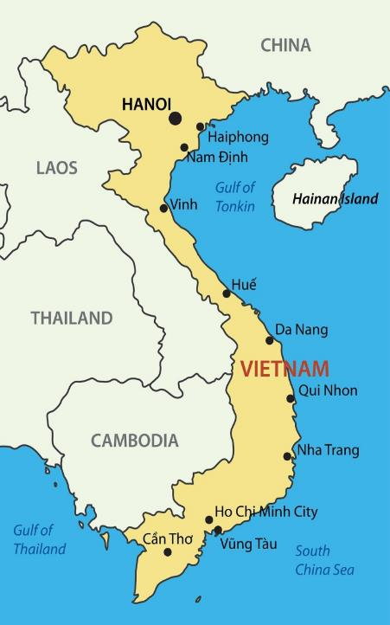
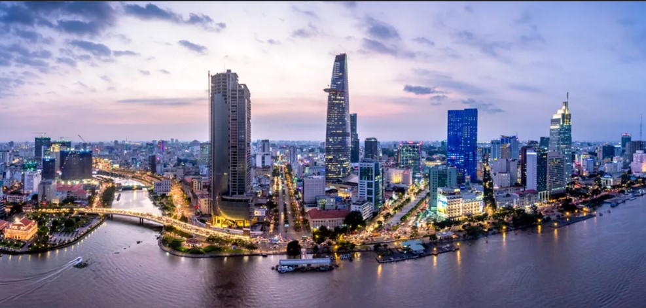

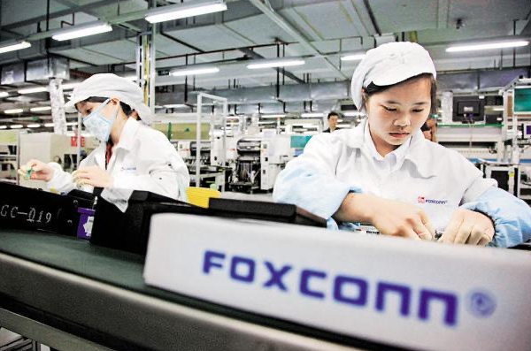

Bac Ninh
Bac Giang
Quang Ninh
Welcome
To Foxconn Vietnam!!!
Area : 331,410 km²
(64 provinces + 4 municipalities)
Population : 99 million (2023)
Labor force : 52 million (2023)
Foxonn footprint

Slide 6
Fii Vietnam Head Count and Demographics
Total Employees : 26,863 people:
Bac Ninh Site: 6,096 people
Bac Giang Site: 20,924 people
FG次 Vietnam workforce staff, 46% from 18 to 25 years old
Major employees are Female(52%)
Major engineers and office staff graduated University

Slide 7


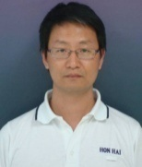









ALT CFT Org.
BU Sr. VP
Kevin Liu
QA Director
Simon Liu
Plant Mgr
David Yin
QA Mgr
Qing-Bo Lin
PM Ben Trinh
PC Tam Nguyen
PE/RE Jack Han
TE Mark Wu
AT/IE Poulo Wang
ME Cheng-Lun
PD WenYong
QA Toney Tu
PM An Tran
PC Nhai
PE Michael
TE Allan
IE Haily
ME Thai
PD Van Anh
PQE Rachel

Slide 8
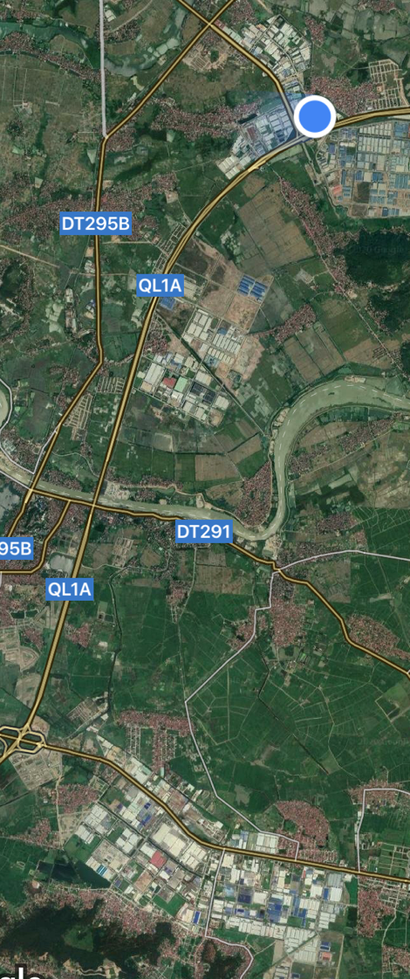
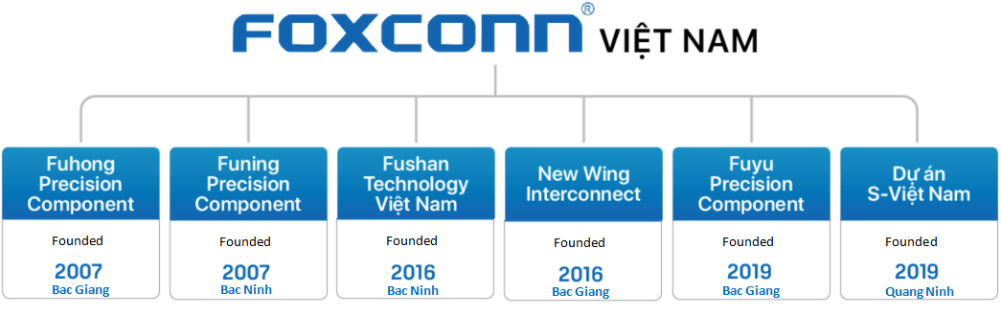












Foxconn Vietnam Overview
Bac Giang
Dinh Tram IP
Fii
Fii
Bac Giang
Van Trung IP
Project
Bac Giang
Quang Zhou IP
Major Enterprise, Infrastructure, Consumer, & Service Provider Customers have been leveraging our Vietnam Supply Chain Services/Solutions !
4KM
15KM
Bac Ninh
Que Vo IP
Fii Confidential

Slide 9
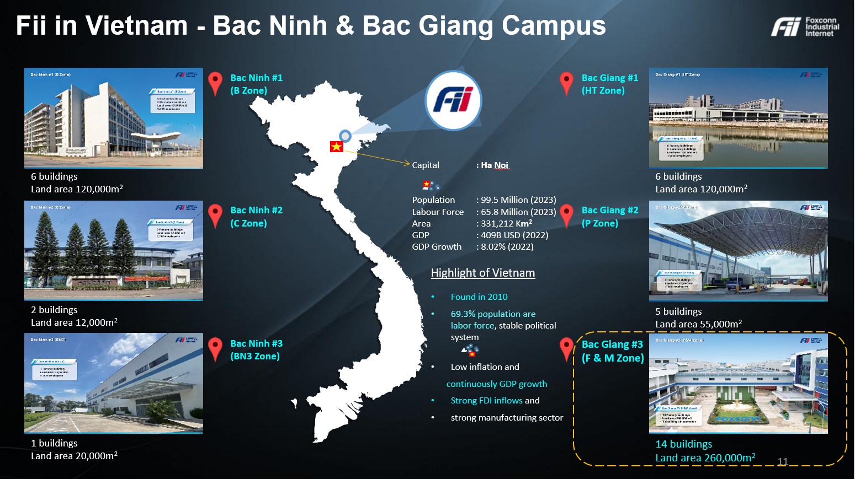

Slide 10

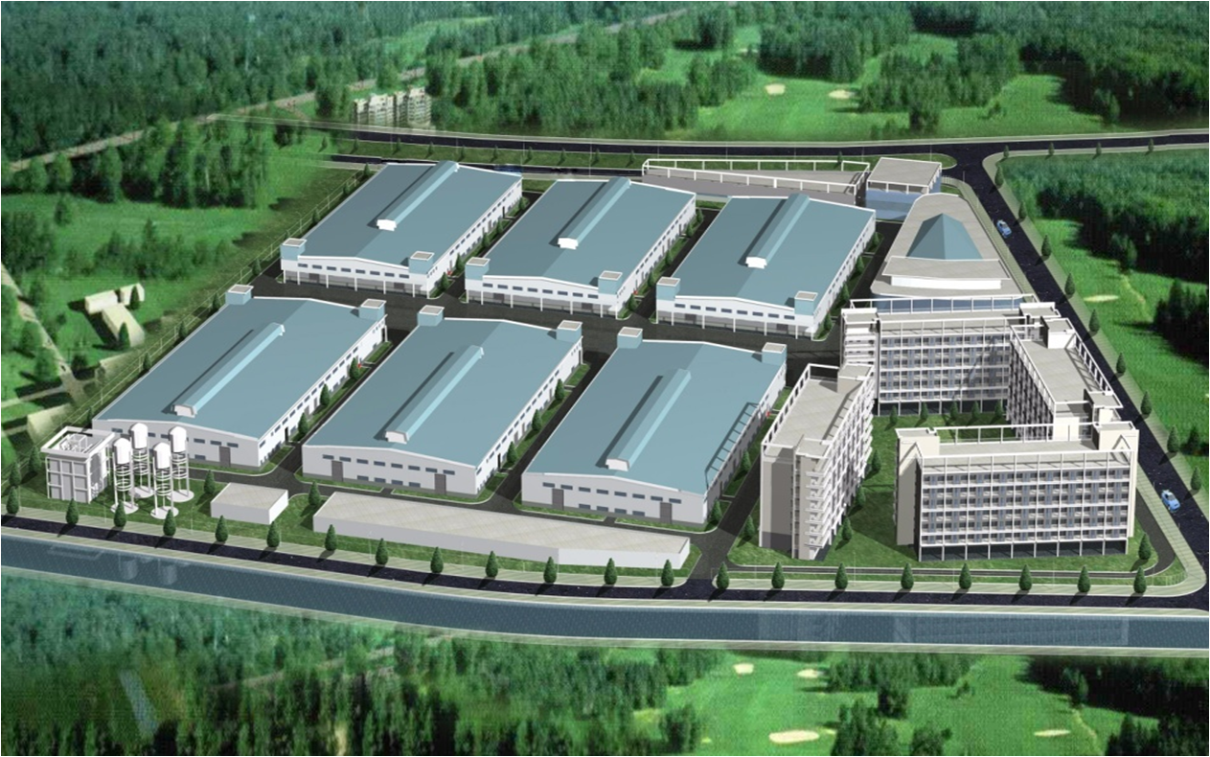
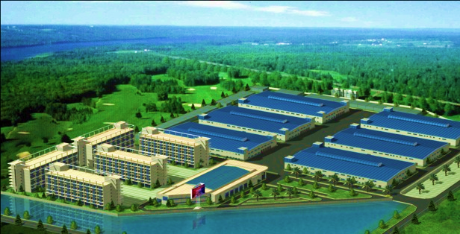
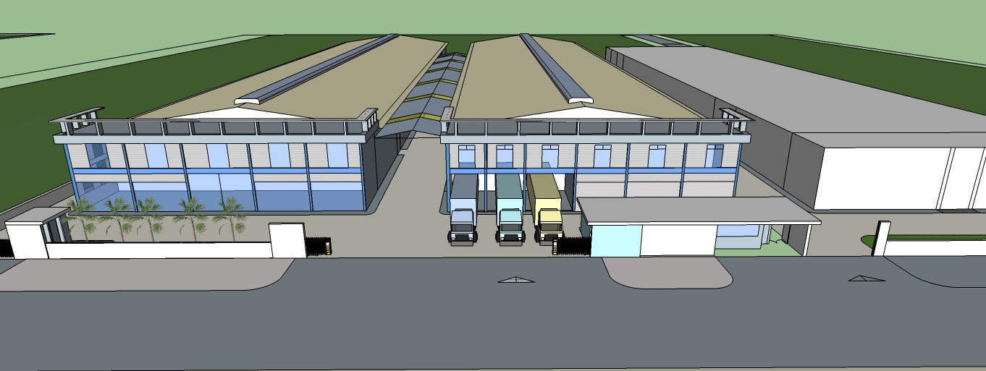
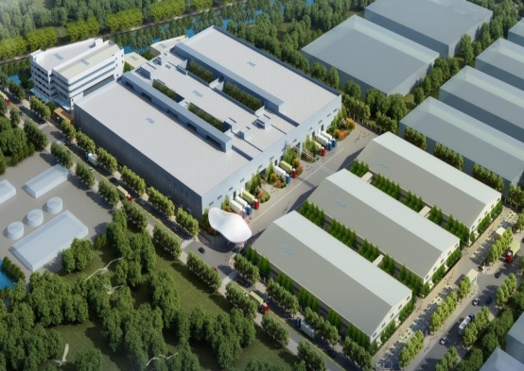
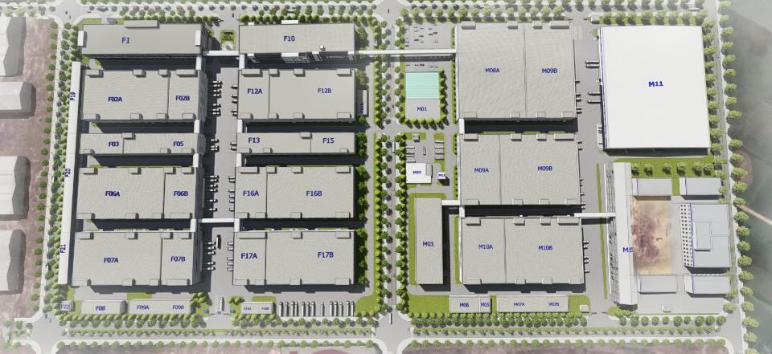
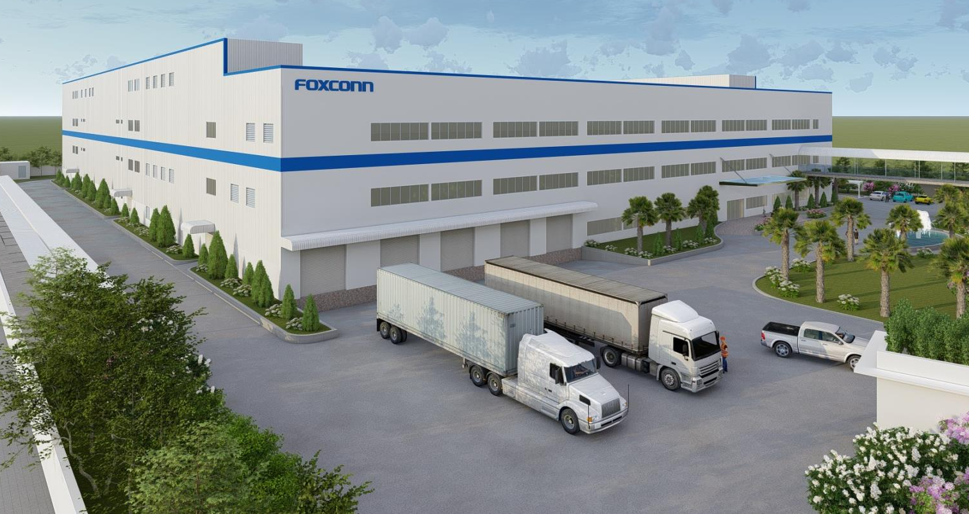
Foxconn VN Fii – Bac Ninh & Bac Giang Campus- 29 buildings
Bac Ninh #1
(B Zone)
Bac Giang #1
B03
B02
B01
6 Factory buildings
5 Dormitory buildings
Land area 120,000 m2
Production area: 65,000m2
Fii : 32,500m2
10,000 employees (Fii: 4,500 employees)
A03
6 Factory buildings
4 Dormitory buildings
Land area 120,000 m2
Production area: 68,400m2
Fii : 55,500m2
9,500 employees (Fii : 8500)
A02
B03
B06
B05
B04
A01
B02
B01
Bac Giang #2
(P Zone)
P05
Bac Ninh #2
(C Zone)
C03
C02
P06
P05A
5 Factory buildings
Land area 55,000 m2
Production area: 52,000m2
2,000 employees
P01
2 Factory buildings
Land area 12,000 m2
Production area: 13,000m2
1,200 employees
P02
P03
Bac Giang #3
(F&M Zone)
Bac Ninh #3
(BN3)
BN3
Total planning 12 Factory buildings
Land area 260,000m2
6 Factory buildings production on going
M zone building under construction
(M08/ M09/ M10)
Total production area: 310,000m2
1 Factory building
Land area: 20,000m2
Production area: 31,000m2
2,500 employees
10
Notes:
10

Slide 11
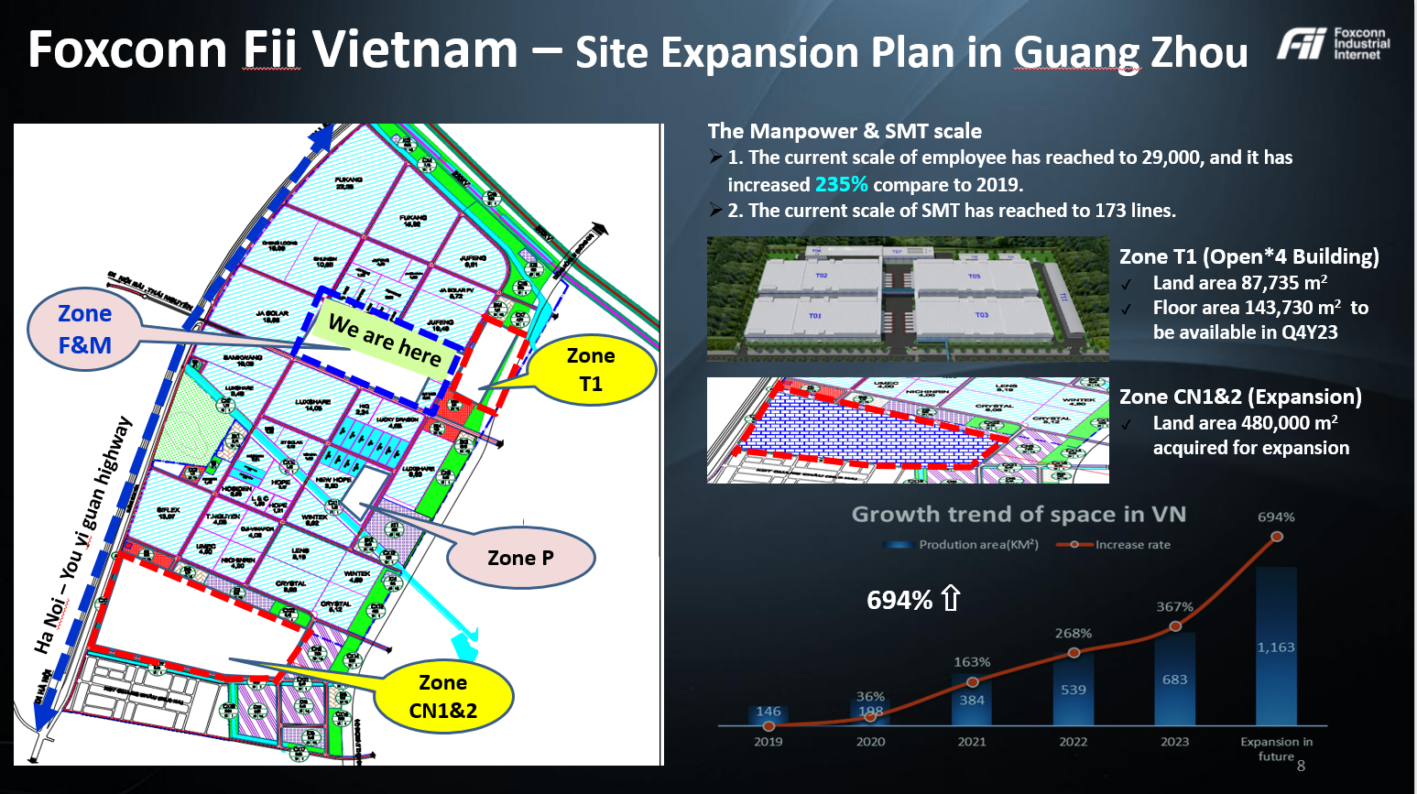

Slide 12
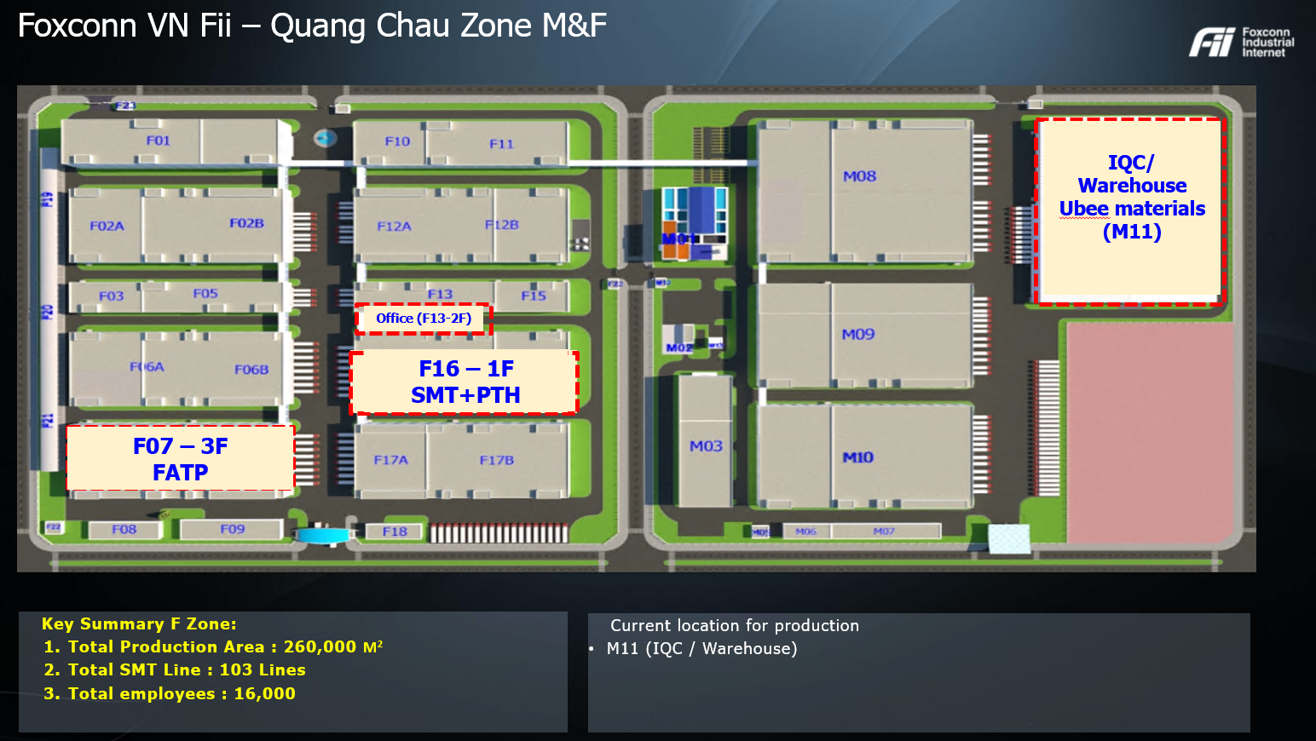

Slide 13
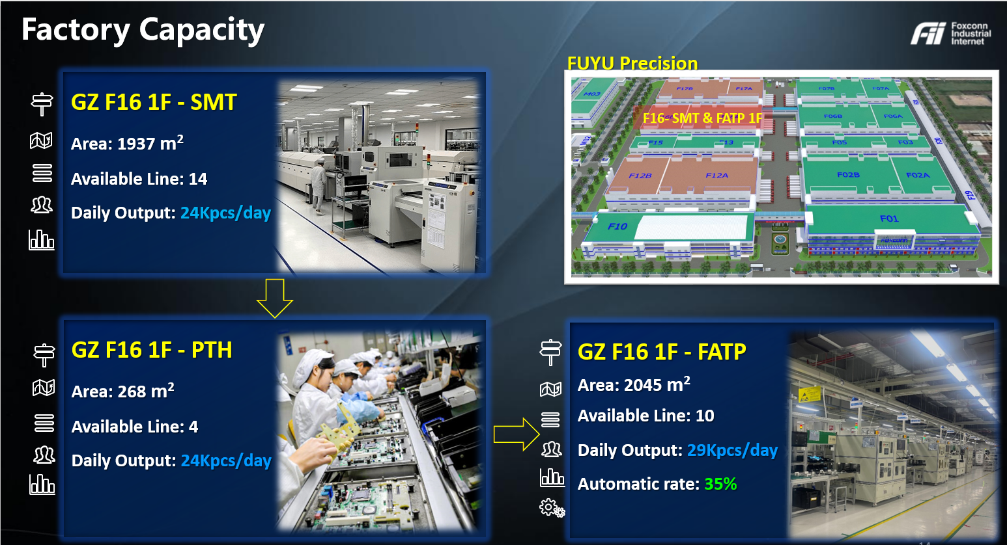

Slide 14
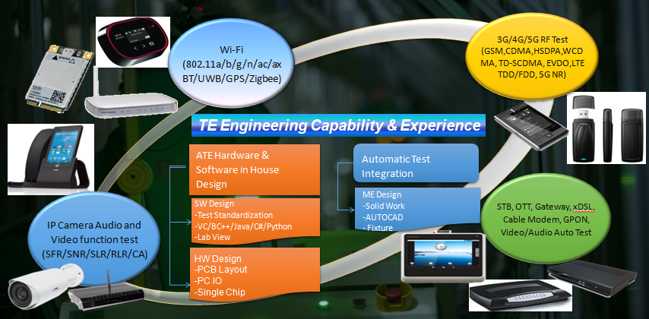
Fii VN Engineering Capabilities and Service_Test

Slide 15
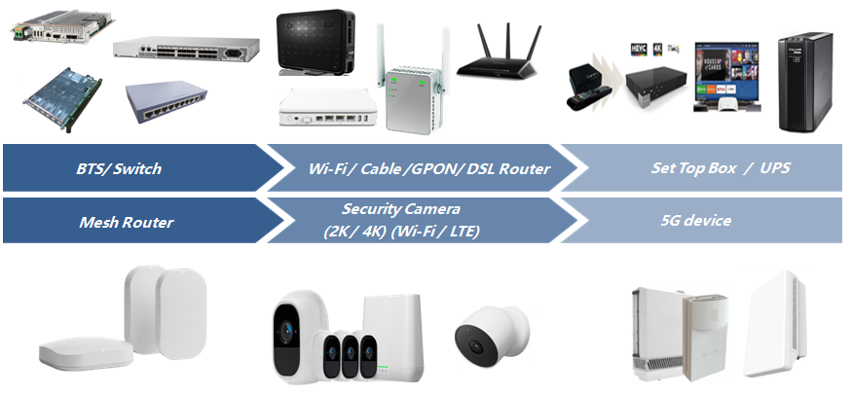
Fii Vietnam Main Products

Slide 16
Fii Vietnam Products build and Capacity
Kpcs
Tablet/Speaker/ Display/SWITCH/ Floodlight …
Fii Site Capacity |  | Lines | Daily Capacity (Kpcs) | Monthly (Kpcs)
SMT capacity | Bac Ninh | 45 | 113 | 2,938
 | Bac Giang | 108 | 310 | 8,381

Slide 17
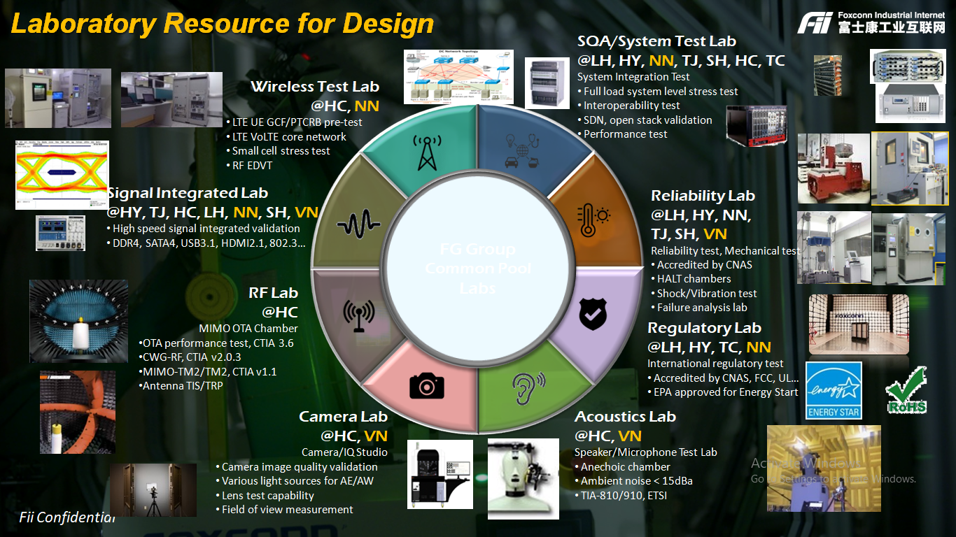

Slide 18
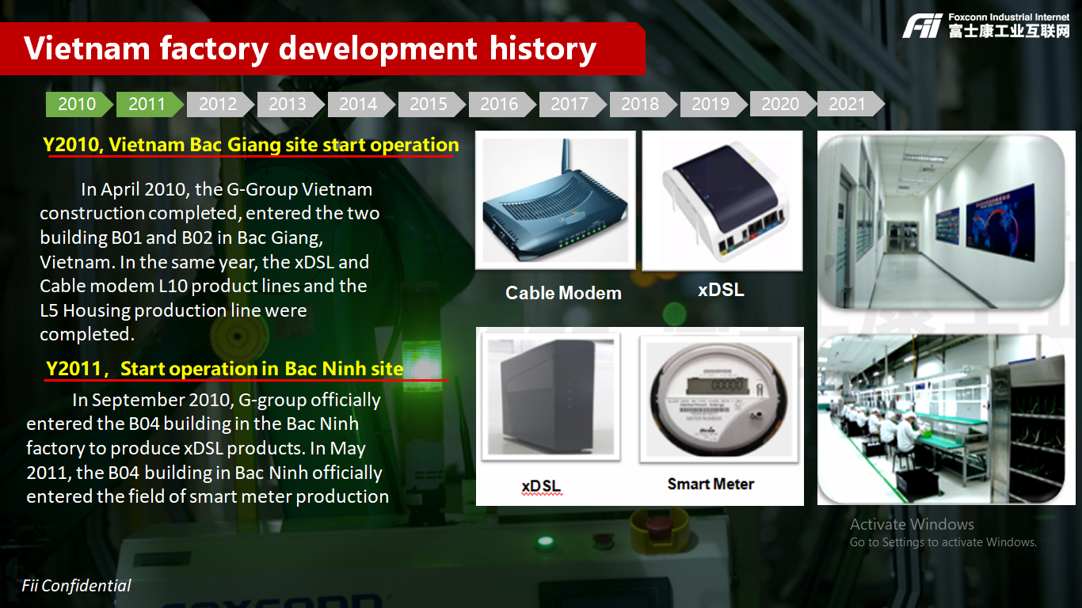

Slide 19
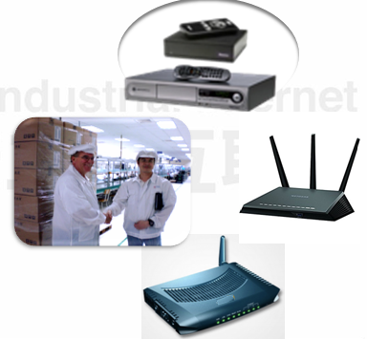
Vietnam factory development history
2010
2011
2012
2013
2014
2015
2016
2017
2018
2019
2020
2021
Y2012/4 Bac Giang B01 start build/shipment STB
In March 2012, G-group established a professional set-top box production line in Bac Giang B01 with a daily production capacity of 20K.
2012/6 Bac Ninh B05 start build and ship WiFi Router
In June 2012, G-group officially entered the B05 building in the Bac Ninh factory to produce WiFi Router products.
2012/7 Bac Giang A02 start build and ship Cable modem
2012/7 the A02 building in Bac giang start build the Cable Modem production line, with a daily capacity of 15K.

Slide 20

Vietnam factory development history
2010
2011
2012
2013
2014
2015
2016
2017
2018
2019
2020
2021
2015，Established 4G and GPON product lines in A02, Bac Giang, Vietnam
In May 2015, officially entered the 4G product field (MyFi & Outdoor ODU), and in September it entered the GPON product line for mass production, delivery.
2015，Start buiding B06 in Bac Ninh factory
In October 2015, G-Group officially entered the B06 building in the Bac Ninh factory to produce high-end products of WiFi Router.
2016，Established Camera Product Line in B05 in Bac Ninh Vietnam
In May 2016, officially entered the Outdoor Camera product with production capacity 20K/Day.

Slide 21
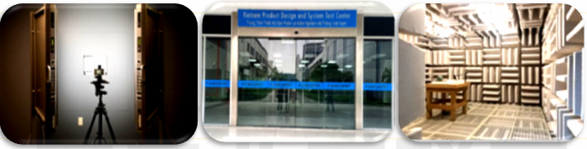

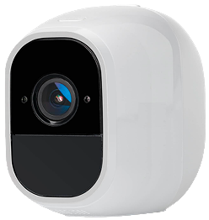
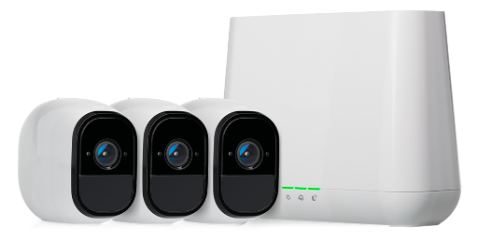


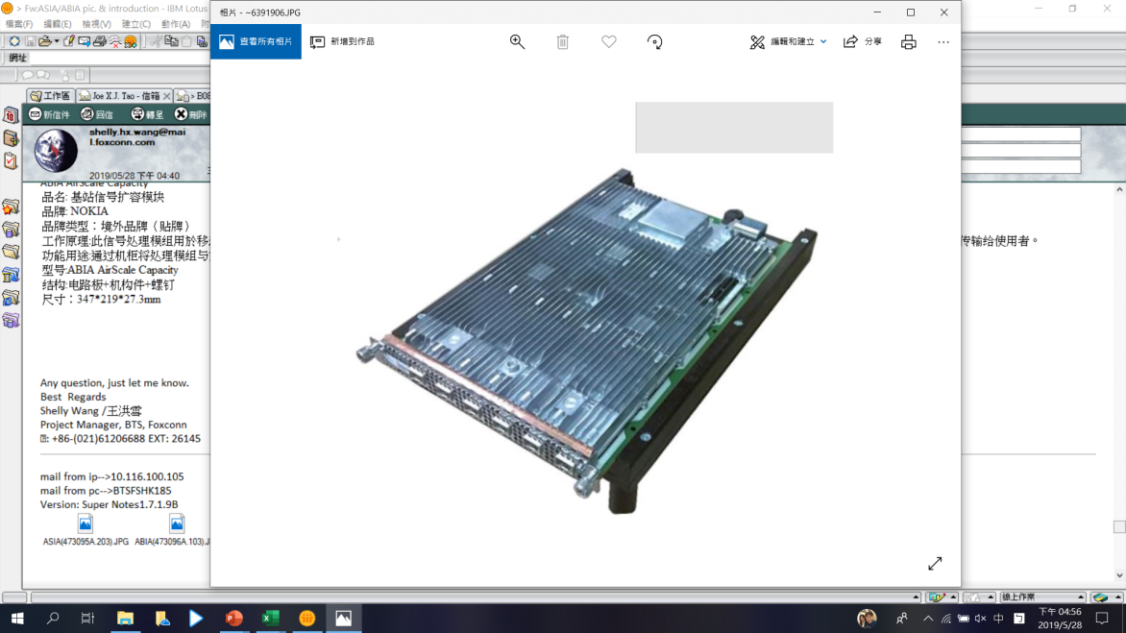
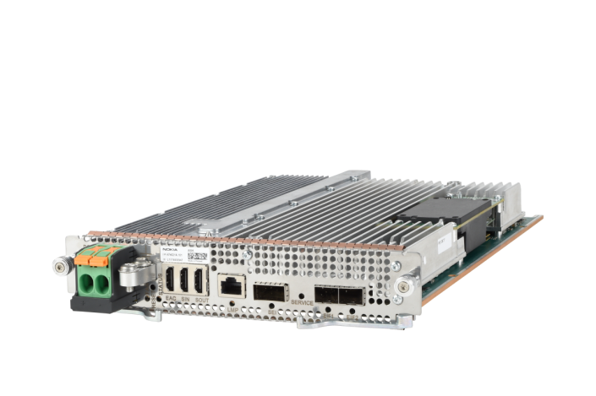
Vietnam factory development history
2010
2011
2012
2013
2014
2015
2016
2017
2018
2019
2020
2021
2017/8，Vietnam R&D Center was established
In August 2017, the Vietnam R&D Center was established in the Bac Ninh factory. The first phase of the STB/GPON developed and deployed for the Southeast Asian market
2018/12，Start B03 building in Bac Nin
In December 2018, G-group officially entered the B03 building in the Bac Ninh factory to produce high-end Cable modem products.
Start build and arrange shipment new products Mesh/IP Camera, BTS

Slide 22
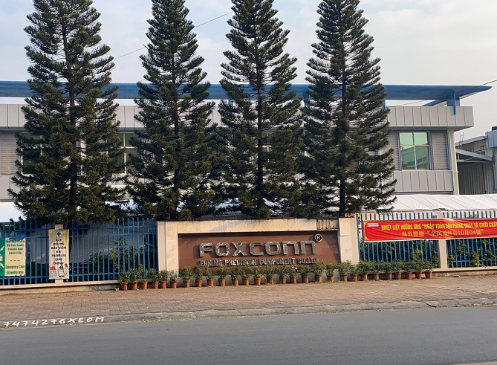
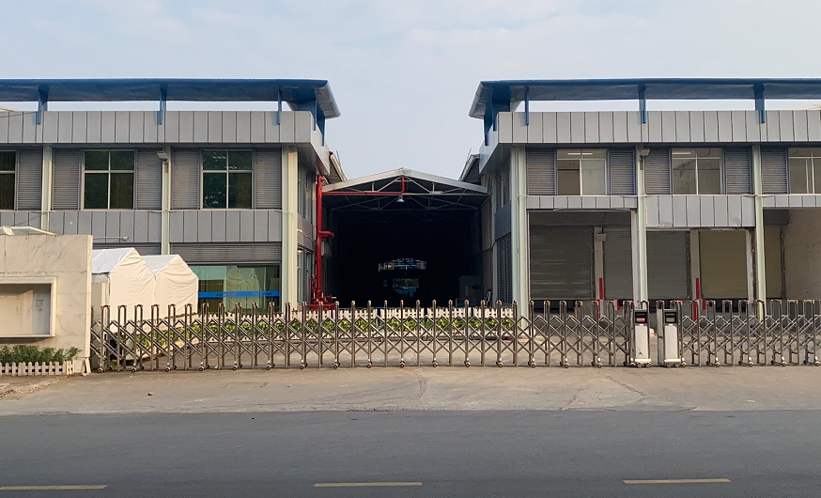
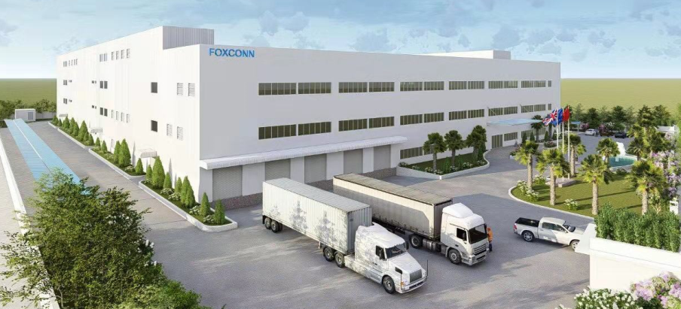
Vietnam factory development history
2010
2011
2012
2013
2014
2015
2016
2017
2018
2019
2020
2021
2019/Q1， Expansion of Vietnam's factory in Bac Ninh (#2)
In 2019/Q1, two plants in C area in Bac Ninh Plant were started, entering the field of Mesh and mobile communication base station system modules production
2019/08，Expansion of Vietnam's factory in Bac Ninh (#3)
Acquisition and construction area of 20,000 square meters in Que Vo industrial zone Bac Ninh#3, put into use 2020/Feb for Wifi AP/IP Camera capacity expansion
C zone - Bac Ninh (#2)
Que Vo Industrial zone - Bac Ninh #3

Slide 23
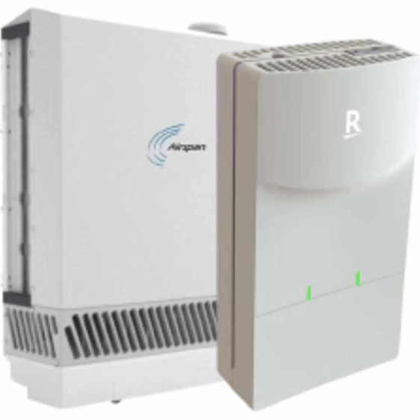
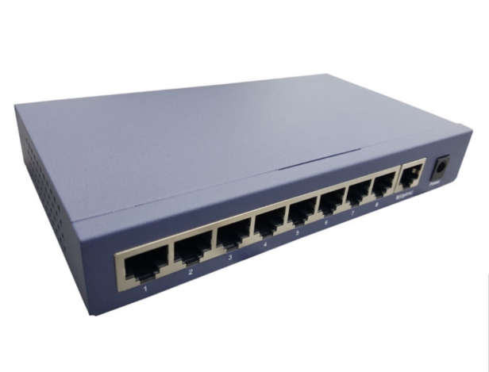
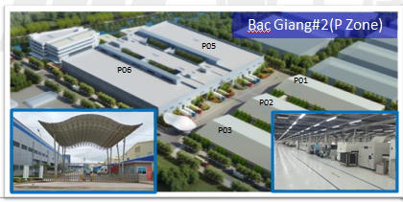
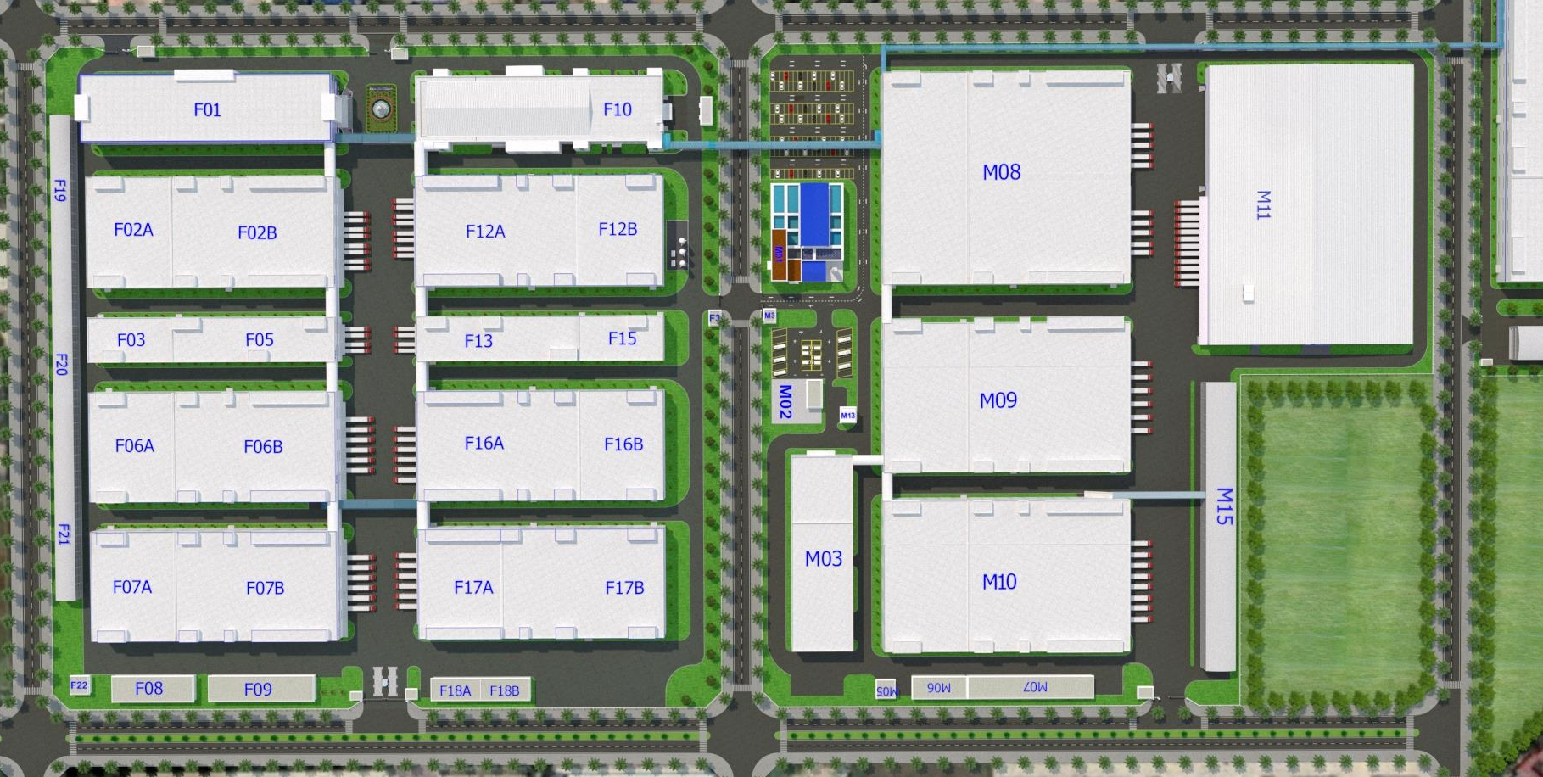
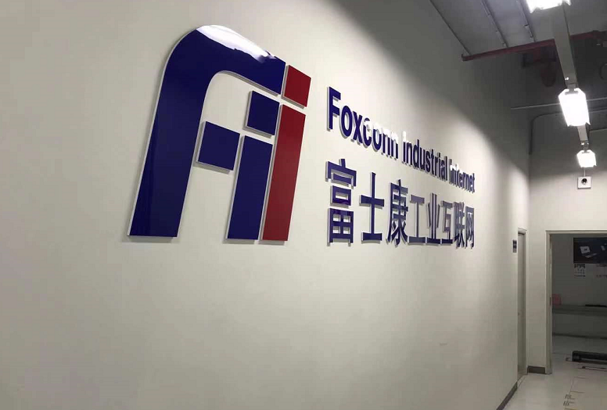
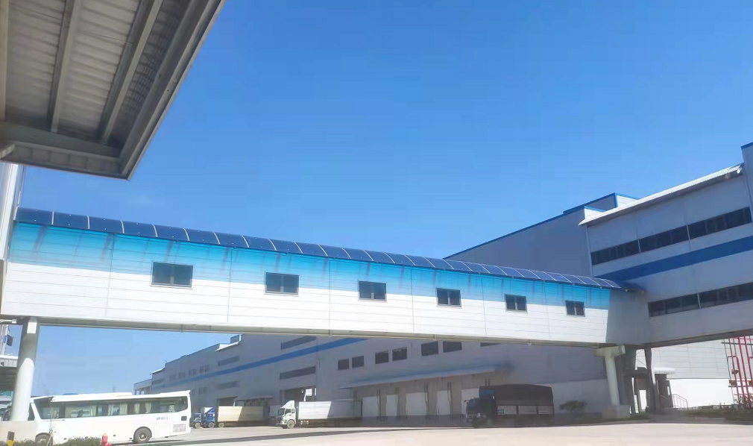
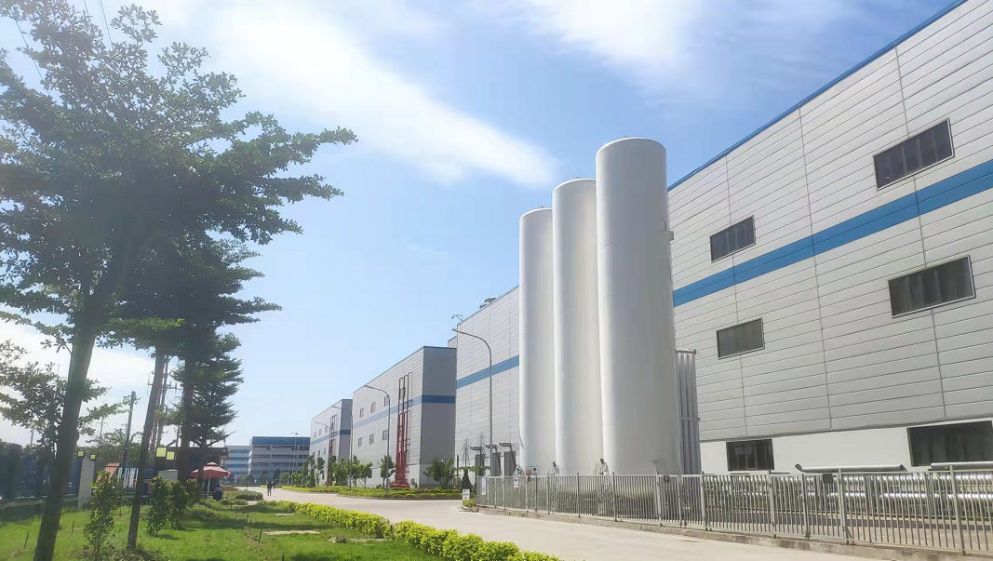
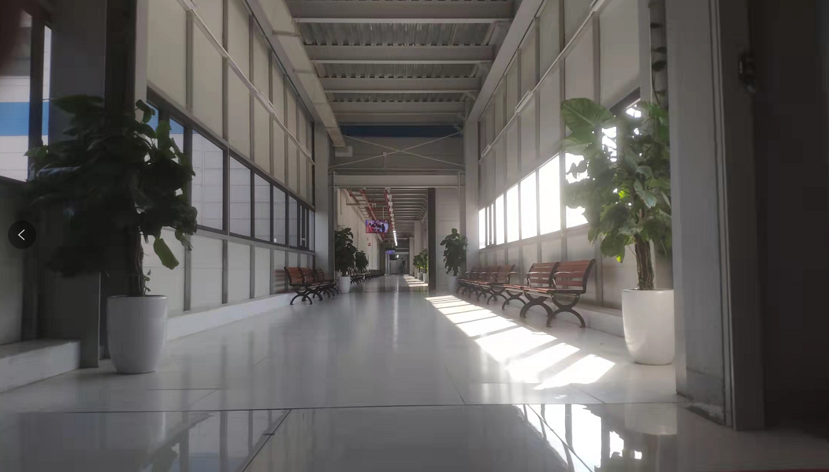
Vietnam factory development history
2010
2011
2012
2013
2014
2015
2016
2017
2018
2019
2020
2021
2020/Q1 First Lot 5G product NPI and shipment
2020/04 start deployed first bath of 5G device shipment
2020/Q3，Expansion of Vietnam's factory in Quang Chau IP
2020/05 Bac Giang #2 start up P05/P06 buildings for Switch/OTT production capacity expansion
2020/08 Bac Giang #3 start up F12/F13/F16/F17 buildings
5G
Switch
F&M zone- Bac Giang(#3)

Slide 24
Agenda Review
Fii Vietnam Introduction & Capability
Supply Chain and Logistic Overview
AGENDA
Quality System & ECN Process
Foxconn Vietnam CSR

Slide 25
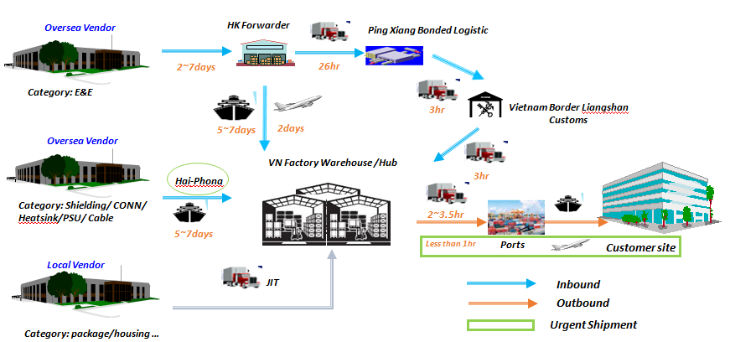
Vietnam Inbound/Outbound Logistic
25

Slide 26
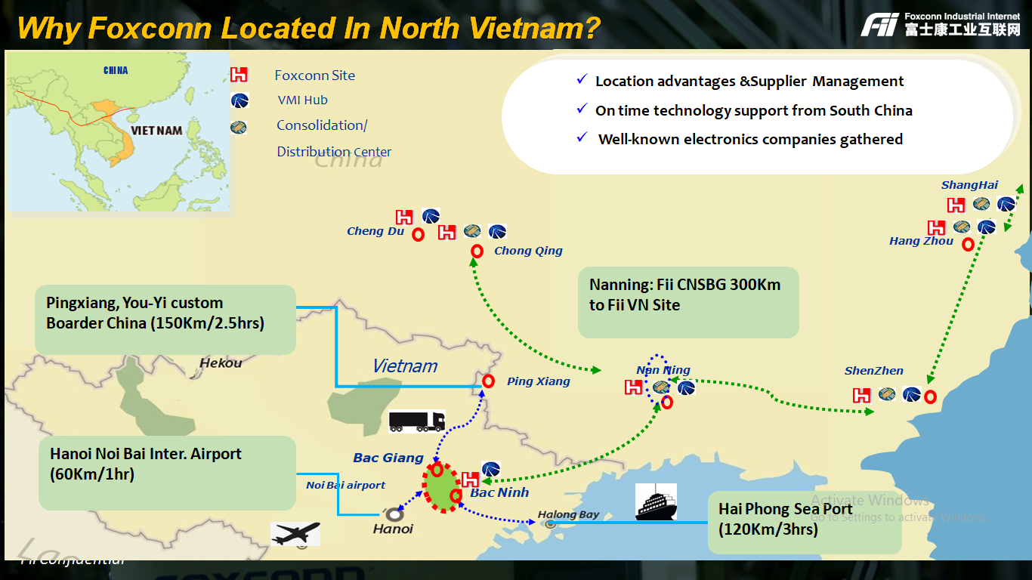

Slide 27
Agenda Review
Fii Vietnam Introduction
Supply Chain and Logistic Overview
AGENDA
Quality System
Foxconn Vietnam CSR

Slide 28
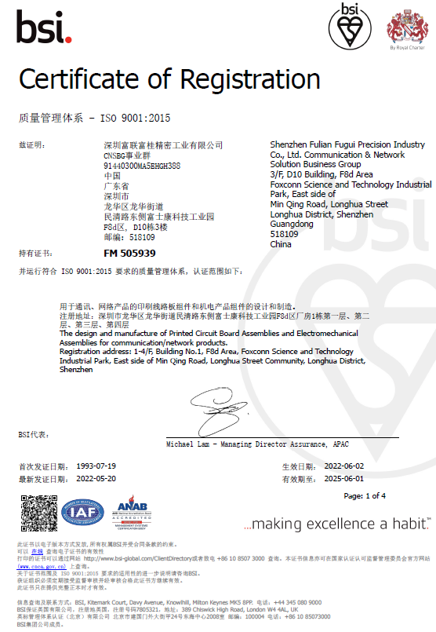
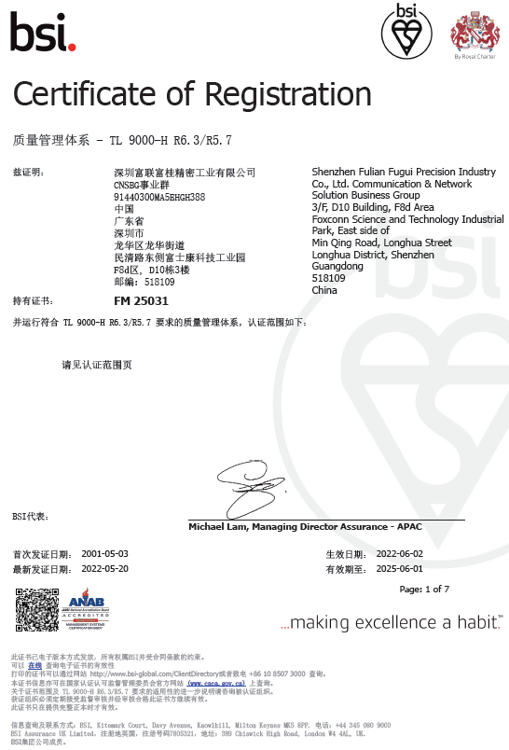
Quality System Certification
ISO9001: 2015
TL9000 –H R6.3/R5.7
Expiry date: 2025-Jun-01
Expiry date: 2025-Jun-01

Slide 29
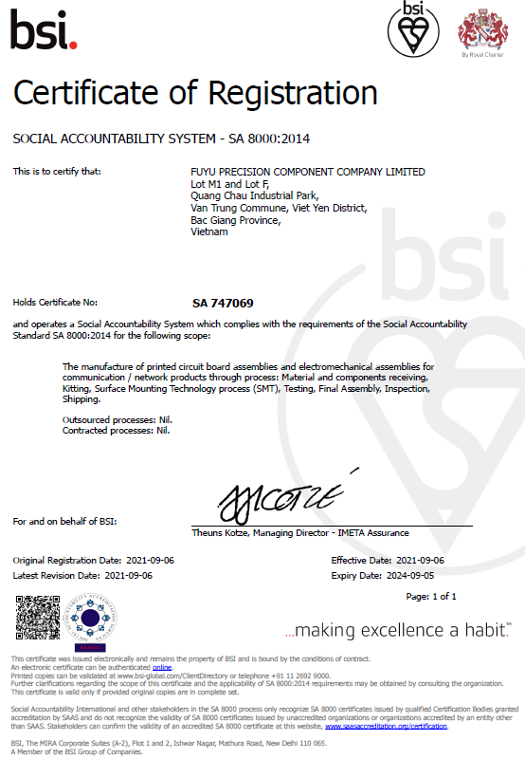
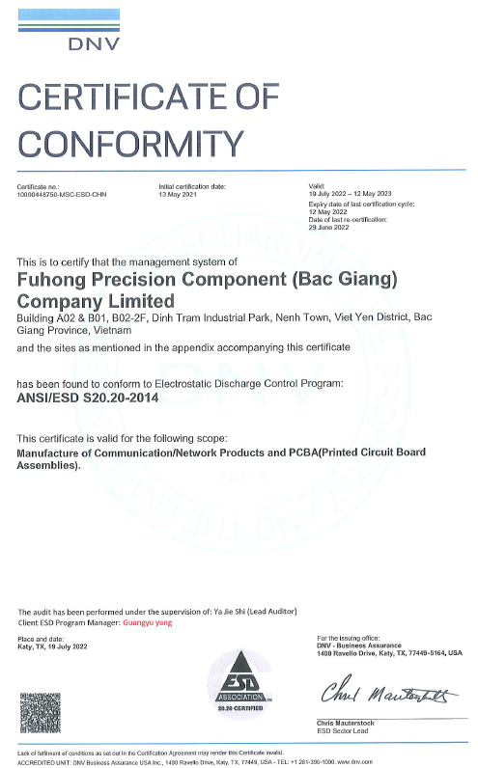
Quality System Certification
SA8000: 2014
ANSI/ESD S20.20-2014
Expiry date: 2023-May-13, re-audit on 2023-Apr.
Expiry date: 2024-Sep-05

Slide 30
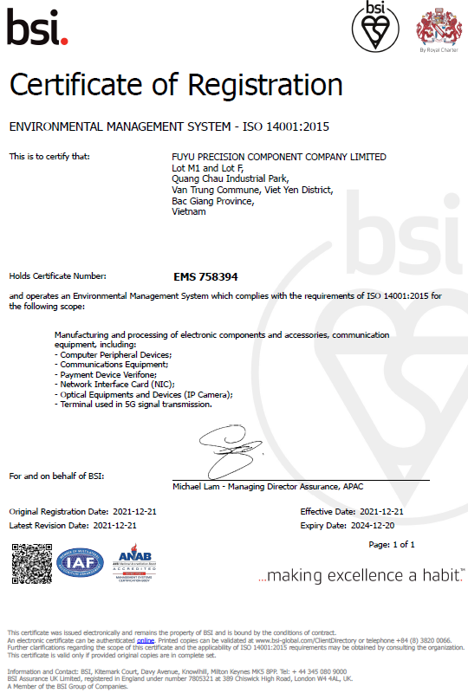
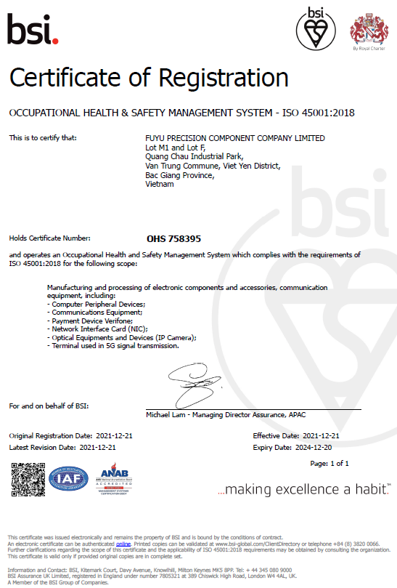
Quality System Certification
ISO14001: 2015
ISO 45001:2018
Expiry date: 2024-Dec-20
Expiry date: 2024-Dec-20

Slide 31
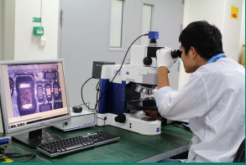




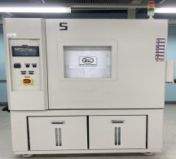
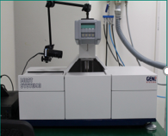
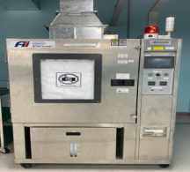
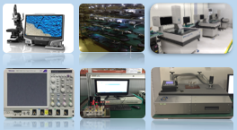






VN QA Lab Capability
RF & SI & 3D(ME)
HDMI 1.4
DDRI/II/III/IV
PCI-E 1.0/1.1/2.0/3.0
2C Timing Test
Flash Timing Test
MDIO/MII/SDIO/GPIO/SPI/UART
Battery Charge Test ( N6705B)
3 D Measurement, object flatness /space, 10X~1000X
2.4GHz &5GHz Tx /Rx /LNA/Noise Figure, S- Parameters & K – Factor
MDVT
Optics/Image
Resolution
Chromatic Aberration
Auto White Balance
Color Fidelity
Saturation
Spatial SNR
Dynamic Range
Lens Shading
Color Shading
Distortion
Auto Exposure
FOV
Vibration Machine
Range: 1~2000Hz
Thermal Shock
Range: -65~150^{O}C
Drop test Machine
Range: 0 ~ 1500mm
Drop Tester
Test height: 30~130cm
Test weight: <60kg.
Burn in Chamber
Acoustics
Sound Pressure Level
Frequency Response
Total harmonic distortion
Recording level
Total harmonic distortion with noise
Temp & Humid Chamber
Temp. Range :-40℃-120℃
Solder ability Test (NBB)
Temp & Humid Chamber
Temp. Range :-70℃-150℃
Thermal Cycling Chamber
Temp. Range :-55℃-150℃
Temp variation: 3~25℃/min
Cross Sectioning Machine
Model: Struers (NBB)
Temp & Humid Chamber
Temp. Range : -60℃-150℃
Humid: 0%，5%-98%
Dye & Pry

Slide 32



VN FA Lab Capability
Dye & Pry
Cross Section
SEM+EDS
Vacuum System
Brand: Buehler
Model: 20-1382-250
Grinding and polishing machine
Brand: PRESI
Model: Minitech 250 DP1
Scanning Electron Microscopes
Brand: Hitachi SU3800
Ion Sputter Coater
Brand: Hitachi MC1000

Slide 33
Agenda Review
Fii Vietnam Introduction & Capability
Supply Chain and Logistic Overview
AGENDA
Quality System & ECN Process
Foxconn Vietnam CSR

Slide 34


Slide 35


Slide 36
Quang Chau campus introduce – F&M Zone
DCN
JBD
NSD
Warehouse
We are here!
NSD-construction
JBD
Expansion
Expansion
MBD
NSD-construction

Slide 37

Production line tour
KT
15:45~16:00
FATP line 10:00-11:00
OBA area
10:00~11:30
SMT Line 16:00-16:45

